Slide 1
10. Introduction to VHDL
Fondamenti di Elettronica
Sergio Spanò – spano@ing.uniroma2.it

Slide 2
VHDL
Vhsic Hardware Description Language
It may look like a programming language but it’s NOT
VHSIC Very High Speed Integrated Circuit
80’s DOD, Departement Of Defence
Born as description language for documentation
In 1993 a new release IEEE (Institute of Electrical and Electronics Engineers) offered the possibility to synthesize VHDL code

Slide 3
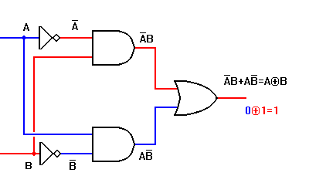
VHDL Abstraction level 1/2
VHDL supports several abstraction level for Digital systems design:
DATAFLOW and RTL (Register Transfer Level): It is described the dataflow of the circuit
BEHAVIOURAL: the system is described according toits behavior
STRUCTURAL: the system is described as a set of subsystems connected together.
C(N)
C(N+1)

Slide 4
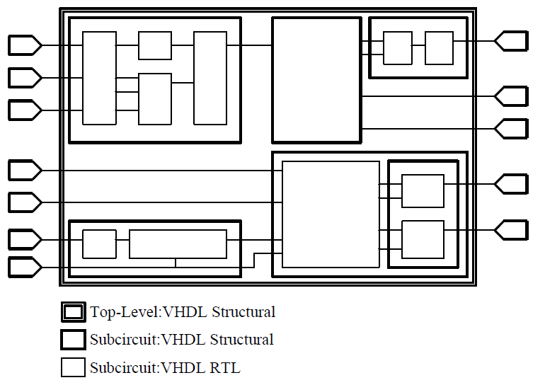
VHDL Abstraction level 1/2
In order to simplify the design Digital systems can be divided in sub-systems
Each subsystem can be described as preferred

Slide 5
VHDL Terms
Entity. All designs are expressed in terms of entities. An entity is the most basic building block in a design. The uppermost level of the design is the top-level entity.
Architecture. All entities that can be simulated have an architectural description. The architecture describes the behavior of the entity. A single entity can have multiple architectures.
Configuration. It describes which behavior to use for each entity.
Package. A package is a collection of commonly used data types and subprograms used in a design. Think of a package as a toolbox that contains tools used to build designs.
Library. Collection of packages.

Slide 6
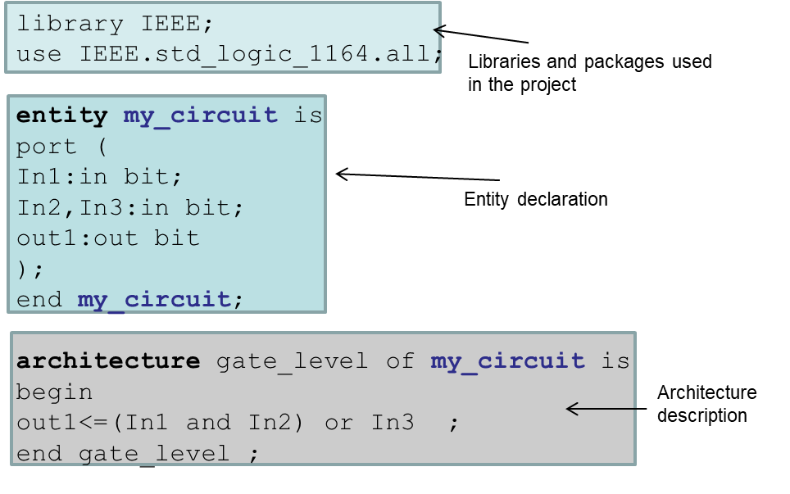
VHDL Example

Slide 7
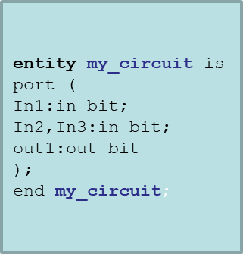
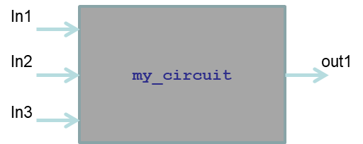
Entity
A VHDL entity specifies the name of the entity, the ports of the entity, and entity-related information. All designs are created using one or more entities.
my_circuit is the name of the entity
The port field contains the description of the I/O of the entity and is characterized by:
Type (Ex. bit,bit_vector...)
Mode (Ex. input, output…)

Slide 8
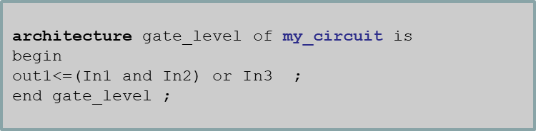
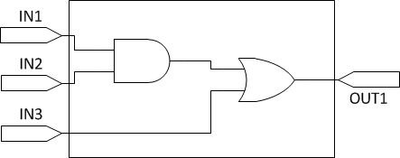
Architecture
The architecture describes the underlying functionality of the entity and contains the statements that model the behavior of the entity. An architecture is always related to an entity and describes the behavior of that entity.
NOTE: after the word architecture can be used any word (rtl,structural,House,dog…)

Slide 9
Assignment
<= is the assignment operator
The assignments are concurrent, so the order of execution is not determined by the order of the statements in the source file
a<=b and c;
d<=e or f;
is equal to
d<=e or f;
a<=b and c;

Slide 10
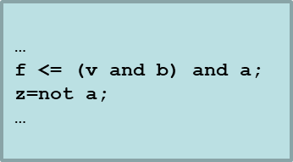
DATAFLOW level VHDL
Gate level description is the lowest level of abstraction allowed by VHDL.
The Entity is described using boolean or math equation.
Complex systems cannot be easily described at gate level.
A common Intel I7 processor is composed by 731.000.000 transistors

Slide 11
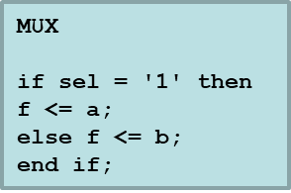
Behavioral level VHDL
This level is used to describe the behavior of an entity without considering how the design is implemented in terms of logic gates.
Behavioral descriptions are supported with the process statement and use syntax statement similar to those used in software (if, case,for…)

Slide 12
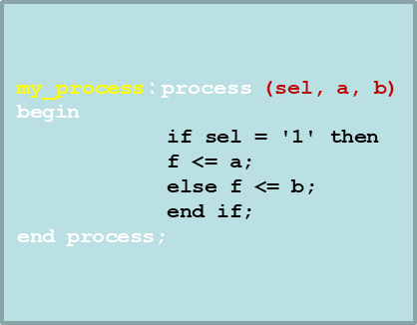
Process 1/2
Some VHDL constructs must be inserted in a PROCESS
The process statement consists of some parts:
Process name (optional)
Sensitivity list: This list enumerates exactly which signals cause the process.
Statement to be executed: contains the operations performed by the process.
When signals in sensitivity list change the statement is executed

Slide 13
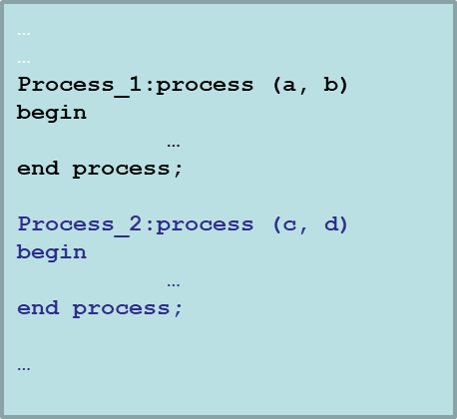
Process 2/2
Like the assignments, processes are concurrent each others.
The synthesizer converts the code into a netlist of objects that correspond to circuits. We can say that the different processes in the code match various hardware blocks that probably will work simultaneously

Slide 14
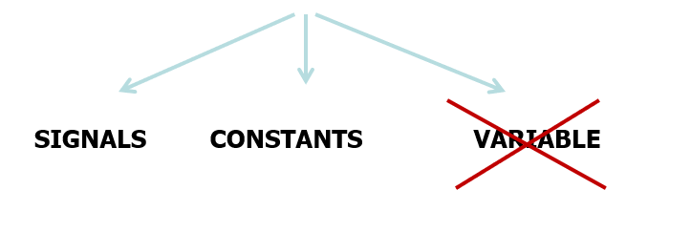
Objects
Objects: Language elements that are used to represent the data
VHDL HAS 3 OBJECT TYPEs
DO NOT USE variables when describing a circuit, they are useful only in the simulation steps

Slide 15
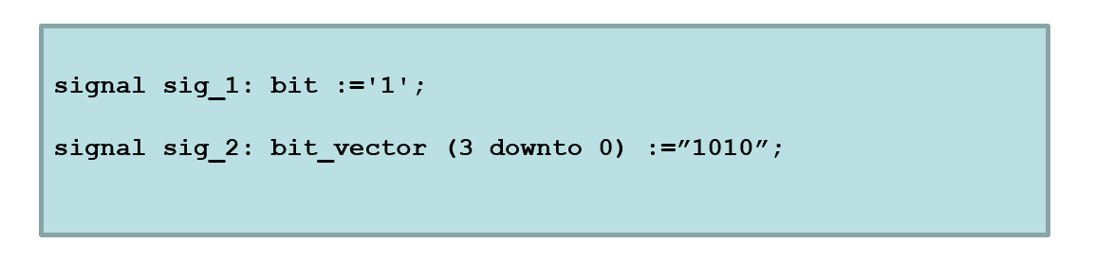
Signals
A signal can represent:
A link between different entities (wire or bus) or any
A quantity that evolves over time (ex registers)
In the declaration is possible to define the initial value of any signal. In processes the value of a signal is updated at the end of the process.

Slide 16
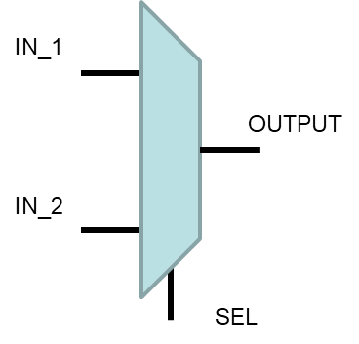
VHDL example 1
GOAL➔ VHDL DESCRIPTION OF A 2 INPUT MULTIPLEXER
DATAFLOW/GATE LEVEL
BEHAVIORAL LEVEL

Slide 17
VHDL example 1
DATAFLOW LEVEL VHDL
library IEEE;
use IEEE.std_logic_1164.all;
entity MUX is
port (
IN_1,IN_2,SEL: in bit;
OUTPUT: out bit
);
end MUX ;
architecture dataflow of MUX is
begin
OUTPUT <=(IN_1 and not(SEL))or (IN_2) and SEL);
end dataflow ;

Slide 18
VHDL example 1
BEHAVIORAL LEVEL VHDL
Entity description as before
architecture BEHAVIORAL of MUX is
begin
process(IN_1,IN_2,SEL)
begin
if SEL=‘1’ then
OUTPUT<=IN_2;
else
OUTPUT<=IN_1;
end if;
end process;
end BEHAVIORAL ;

Slide 19
The event attribute
The ‘event term is a VHDL attribute returning true when there is a change in signal value (i.e., an event).
Thus, when clock ‘event is true, it means that the value of clock has changed.
When the clock= ’1 ‘expression is true, it means that the new value of clock is ’ 1 ’ .
When both expressions are true, it indicates that the clock signal changes to 1 ’, which is the rising edge of the clock signal.

Slide 20
VHDL example 2
FLIPFLOP : Process (clock, reset) --asynchronous reset
begin
if (reset='1') then
Q <= '0';
elsif (clock'event and clock='1') then
Q <= D;
end if;
end process
FLIPFLOP : Process (clock) --synchronous reset
begin
if (clock'event and clock='1') then
if (reset='1') then
Q <= '0';
else
Q <= D;
end if;
end process;

